Slide 1







Lecture 18:
Error Handling
Course - Web Development - III
-By
Pratik Raj Verma
welcome@krmangalam.edu.in
Sohna Road,Gurugram,Haryana 122103

Slide 2

| Table of Contents
Error Handling
try-catch
Custom Error Middleware
References.
The End.

Slide 3

|
Imagine you open Instagram and request a post like /posts/99999, but that post does not exist. Instead of crashing, the application should display a proper message such as "Post Not Found".
Handling such unexpected situations gracefully is called Error Handling, which helps keep applications stable and user-friendly.

Slide 4
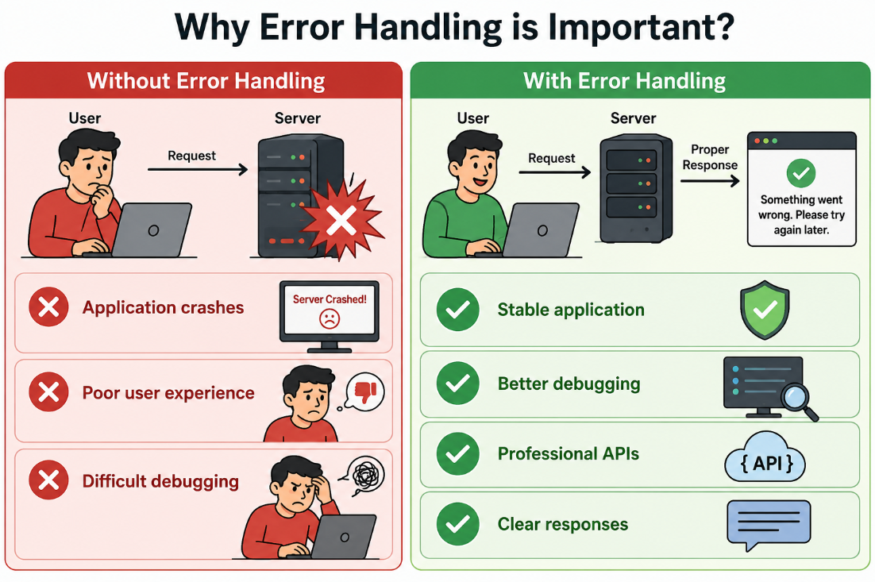
| Error Handling?
Error Handling is the process of catching errors and sending meaningful responses to the client instead of crashing the application.
Purpose:
Prevent crashes
Improve user experience
Return meaningful responses

Slide 5
| Error Handling?
Common Errors in Backend
Examples:
Student not found
Wrong ID
Invalid route
Database connection failure
Programming bugs
Question: How do we handle these situations?
Answer: Error Handling

Slide 6
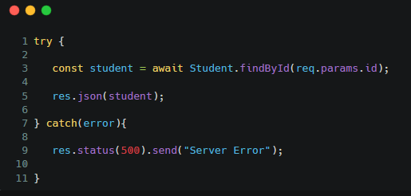
| Error Handling?
Using try-catch :
try-catch is used to catch errors during execution.
Especially useful for:
Database operations
Async functions
External API calls
How try-catch Works :
try
↓
Execute Code
↓
Error?
↓
Yes
↓
catch
↓
Send Error Response

Slide 7
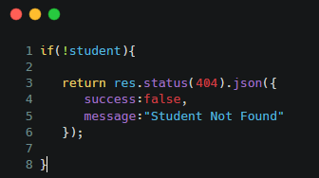
| Error Handling?
Handling Invalid Student ID
It means checking whether a student with the requested ID exists before performing any operation.
If the ID is invalid or not found, the application should return a proper error message instead of crashing.
Response:
{
"success":false,
"message":"Student Not Found"
}

Slide 8
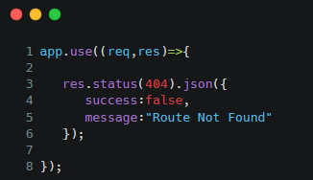
| Error Handling?
Invalid Route Middleware
Invalid Route Middleware is a middleware used to handle requests for routes that do not exist in the application.
When a user tries to access an undefined URL, it returns a proper error response (usually 404 Not Found) instead of leaving the request unresolved.
Important:
Always place this after all routes.

Slide 9
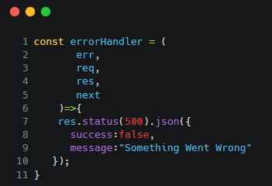
| Error Handling?
What is Error Middleware?
Express provides a special middleware for handling errors.
Normal Middleware:
(req,res,next)
Error Middleware:
(err,req,res,next)
Custom Error Middleware :
Purpose:
Handle all application errors from one place.

Slide 10
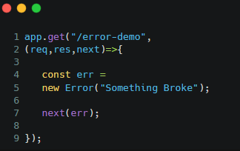
| Error Handling?
Triggering Error Middleware
Explanation:
next(err)
sends control directly to Error Middleware.

Slide 11
| Error Handling?
Error Handling Flow Diagram
Client Request
↓
Route Handler
↓
Error Occurs
↓
next(err)
↓
Error Middleware
↓
Error Response

Slide 12

| Check Your Understanding
Question : What is the main purpose of Error Handling in Express.js?
Options : A. To create routes
B. To connect databases
C. To prevent application crashes and send meaningful responses
D. To install middleware
Answer : C. To prevent application crashes and send meaningful responses
Explanation:
Error Handling helps applications:
remain stable
avoid unexpected crashes
send proper error messages to clients

Slide 13
| Check Your Understanding
Question : Which block executes when an error occurs inside a try block?
Options : A. finally
B. if
C. catch
D. next
Answer : C. catch
Explanation:
If an error occurs inside the try block, JavaScript immediately jumps to the catch block.

Slide 14
| Check Your Understanding
Question : Which function is used to pass an error to the Error Handling Middleware?
Options : A. res.send()
B. req.body()
C. app.listen()
D. next(err)
Answer : D. next(err)
Explanation:
When an error occurs, we use:
next(err);
This tells Express to skip normal middleware and directly execute the Error Handling Middleware.
This is the standard way of forwarding errors in Express.js

Slide 15
| References
MDN Web Docs : Comprehensive and official documentation for Express Js 🔗https://developer.mozilla.org/en-US/docs/Learn_web_development/Extensions/Server-side/Express_Nodejs
W3Schools : Beginner-friendly express tutorials with examples and interactive editors. 🔗https://www.w3schools.com/nodejs/nodejs_express.asp
Express Official- A comprehensive tutorial-style website that covers core Express JS concepts in depth.
🔗https://expressjs.com/en/

Slide 16
Thanks
For
Watching
Course - Web Development - III
welcome@krmangalam.edu.in
Sohna Road,Gurugram,Haryana 122103

